Slide 1
Demographics and Restaurant Preferences
Team “Divas and the Brain”
Reyna, Shetu, and Brian

Slide 2
STARTING dataset
US Census Bureau race data for each zip code
US Census Bureau income data by zip code
Over 30,000 zip codes
Initial Challenges:
Zip codes are stored as different types in each database (string vs integer)
Zip codes in Puerto Rico
Zip codes with zero or very low population count
Filtered data: ~10,000 U.S. zip codes

Slide 3
Sample zip code distribution

Slide 4
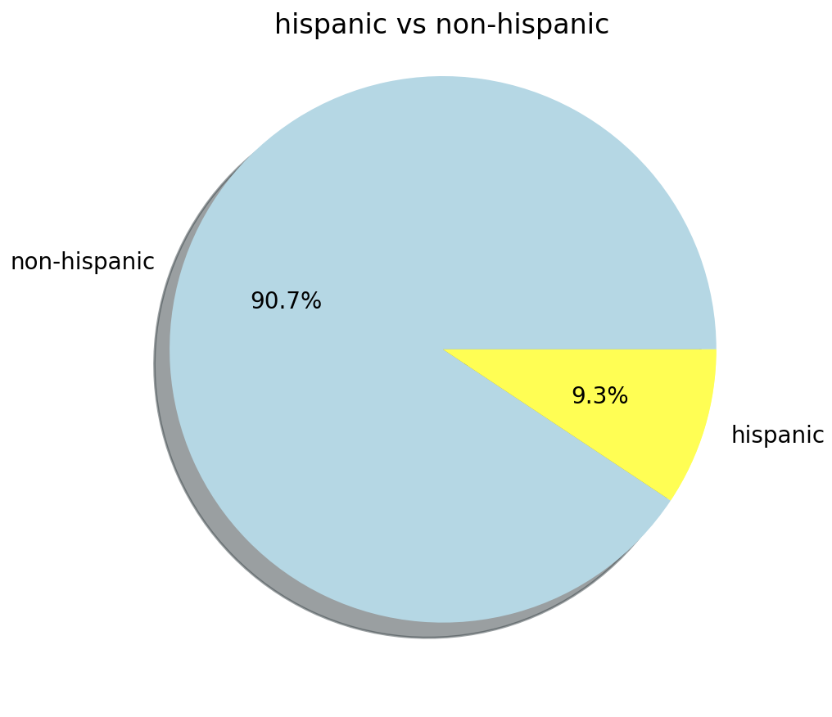
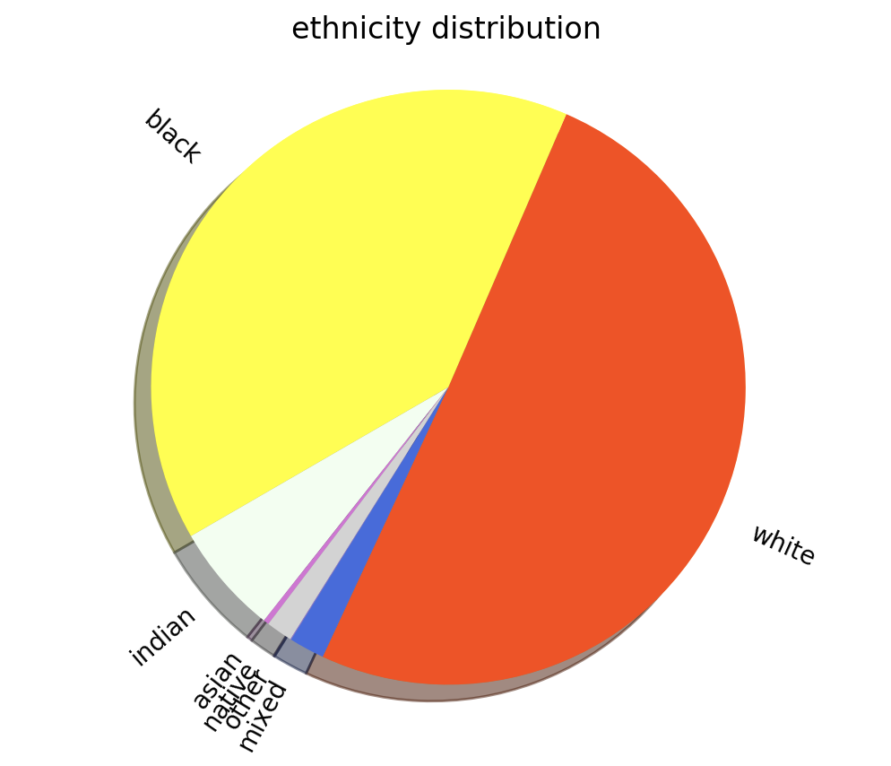
Sample Zip code population

Slide 5

Gathering additional data
Yelp Fusion API
Limited to 5,000 API calls per day
Limited to 50 results per page
Sliced data into 5 random samples of 250 records
Nested “for” loops to query Yelp for each zip code
Gather data by type: Mexican, Chinese, Fast Food

Slide 6
Hypothesis
Correlation between demographics and restaurant preferences
Chose 3 target restaurant types:
Mexican (correlation with Hispanic population)
Chinese (correlation with Asian population)
Fast Food (correlation with income level)

Slide 7
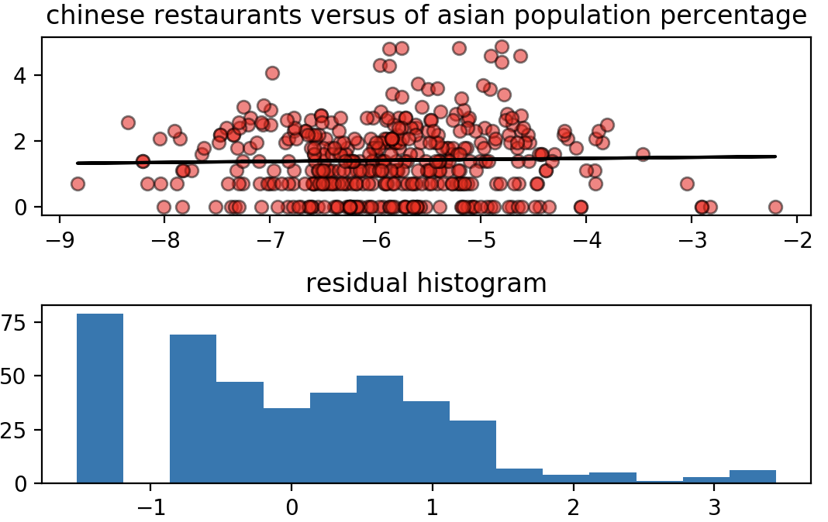
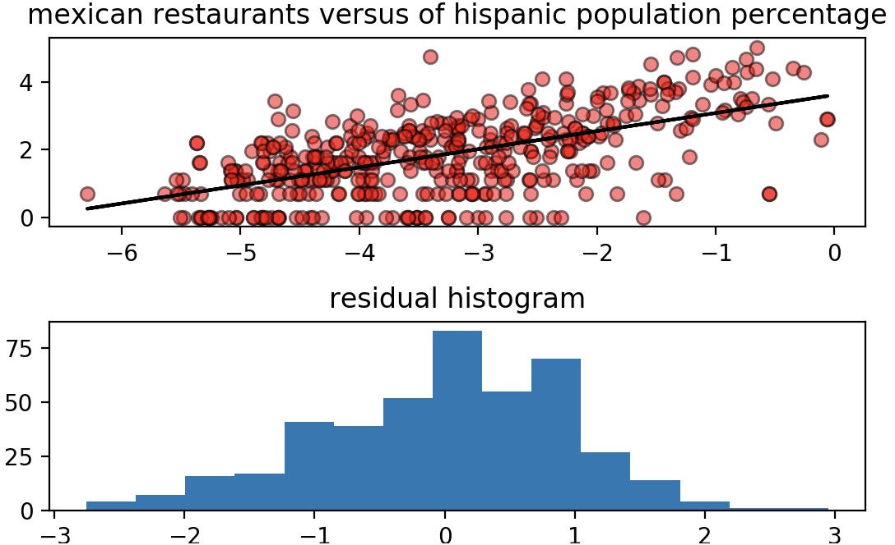
Correlation: Race and Food type
slope: 0.031
r_squared : 0.028
p_value: 0.562
slope: 0.534
r_squared : 0.590
p_value: 0.000

Slide 8
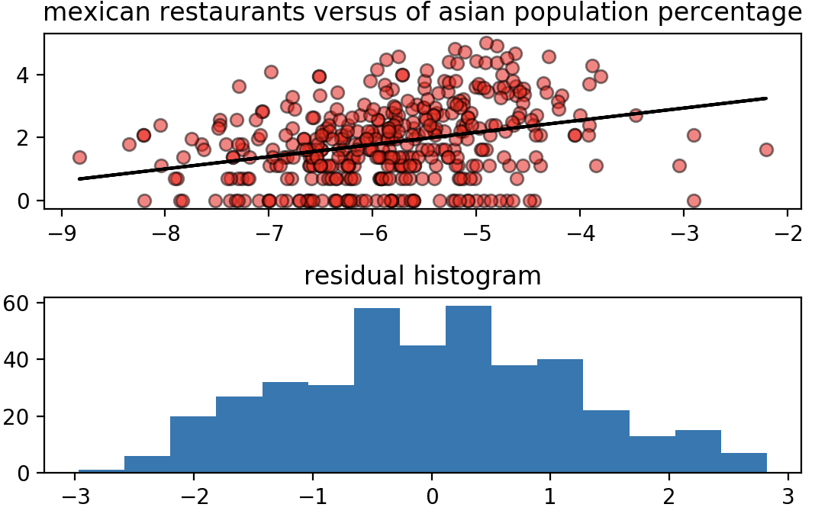
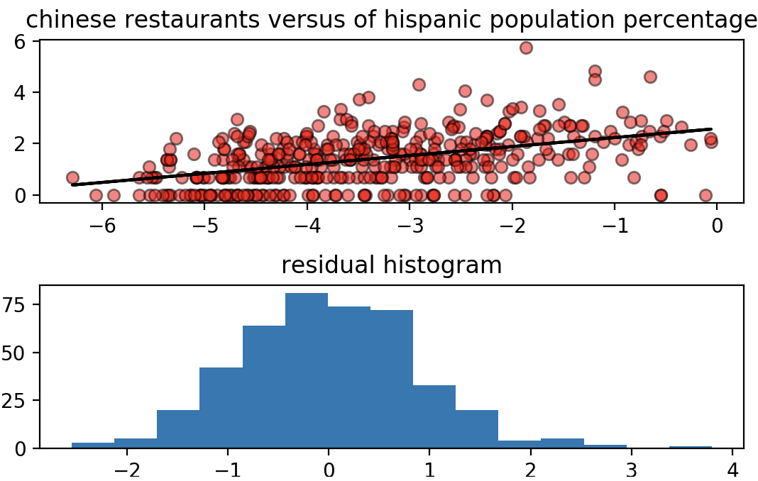
Unexpected results
slope: 0.386
r_squared : 0.305
p_value: 0.000
slope: 0.349
r_squared : 0.453
p_value: 0.000

Slide 9
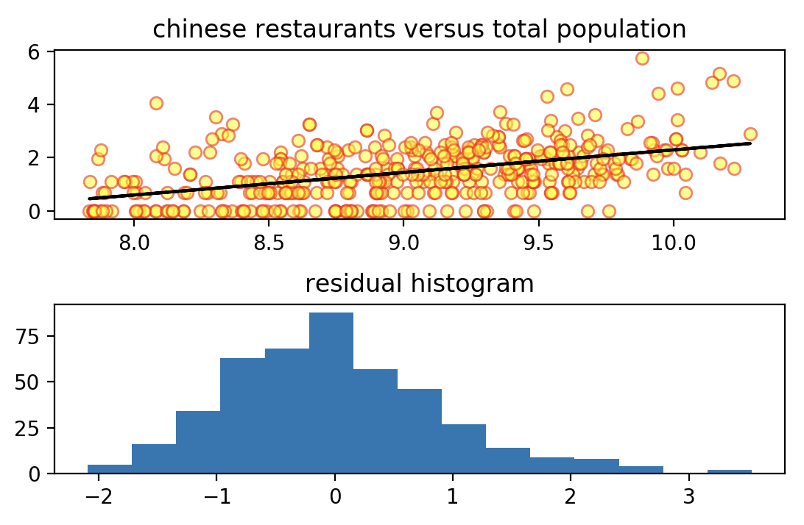
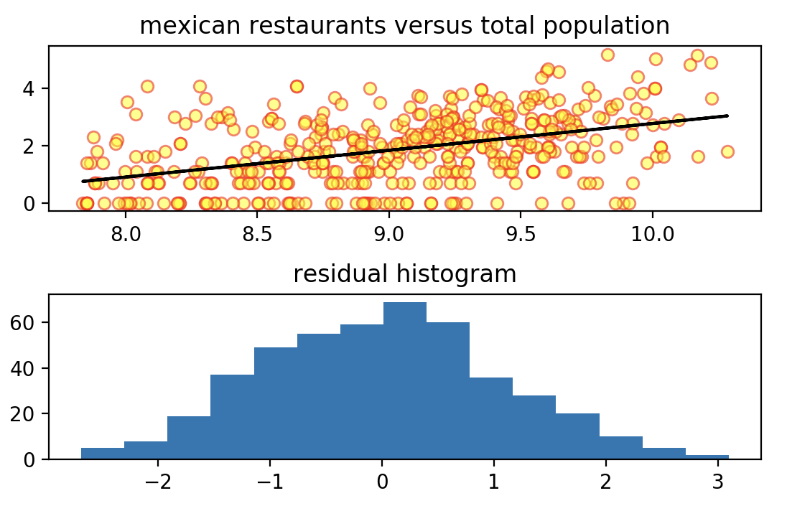
Correlation: Population and Food type
Total number of restaurants for each type is positively correlated to total population!

Slide 10
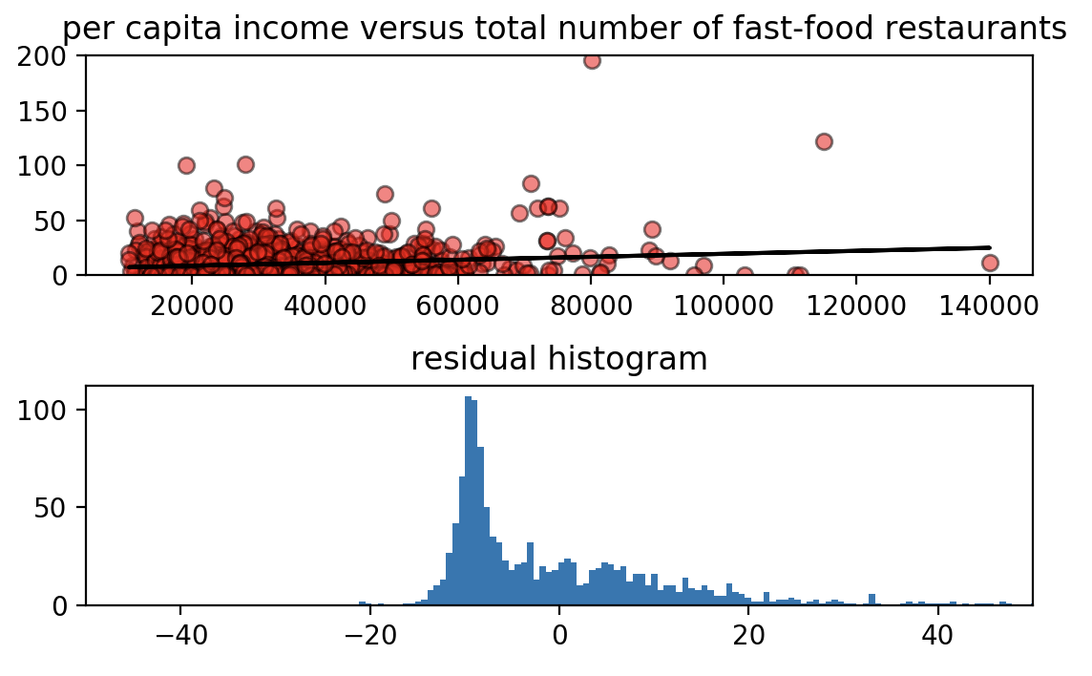
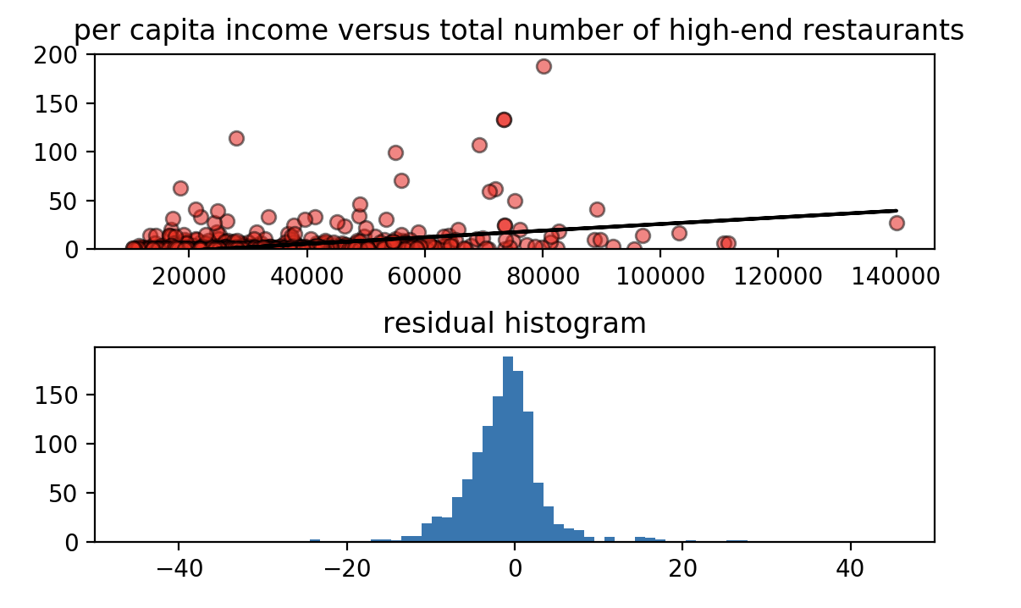
Correlation: Income
slope: 0.00014
r_squared: 0.138
p_value: 0.000
slope: 0.00034
r_squared :0.322
p_value: 0.000

Slide 11
Challenges and limitations
Zip codes do not are not consistent:
Different sizes (geographic)
Irregular boundary shapes
Widely varying populations
Yelp data not fully representative
Not categorize restaurant types correctly
Not cover all restaurants
Correlation and causality

Slide 12
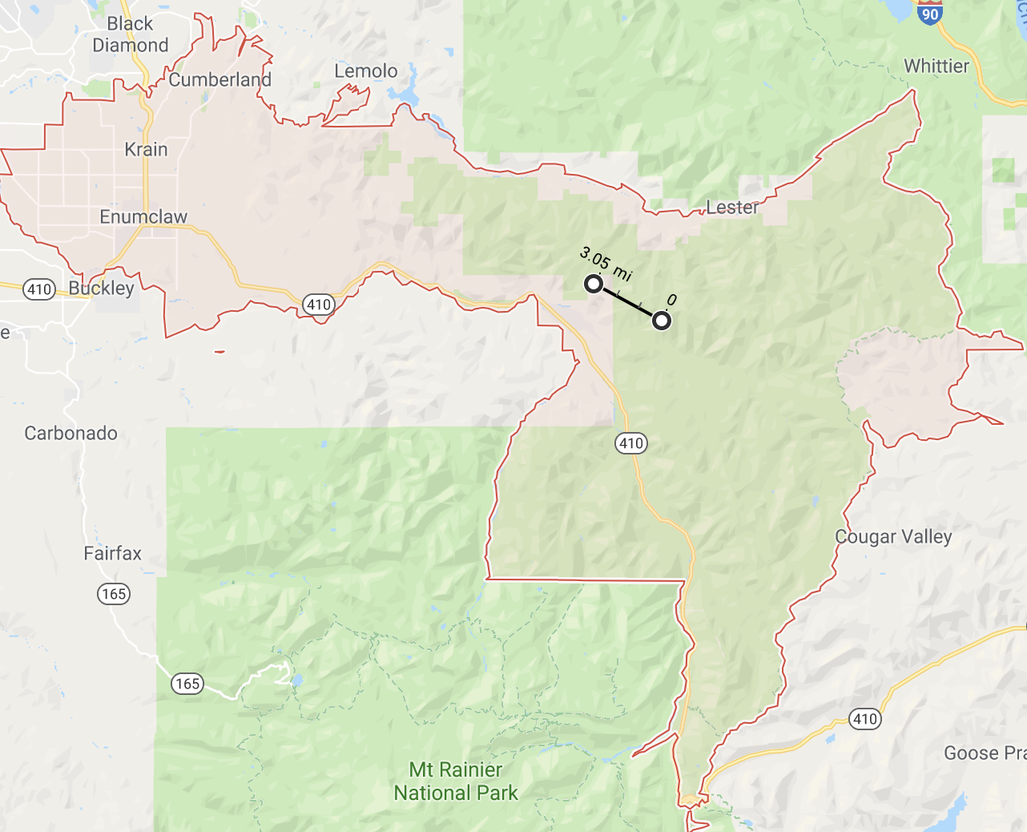
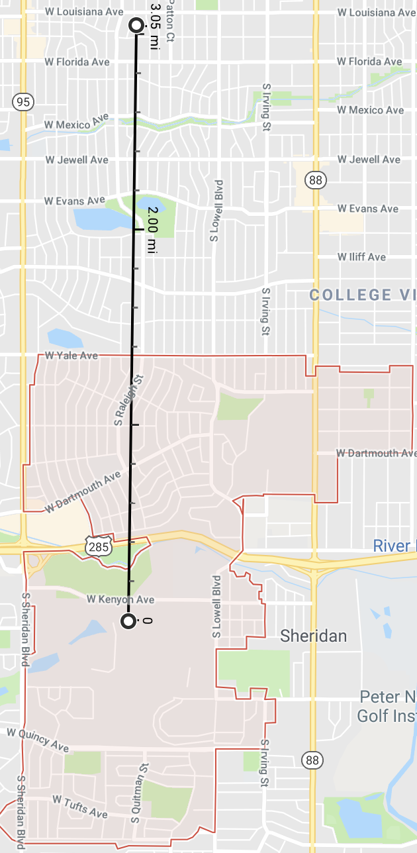

98022 Enumclaw, WA
Total pop: 7,966
Mexican Restaurants: 0
80236 Denver, CO Suburbs
Total pop: 5,917
Mexican Restaurants: 7

